Slide 1
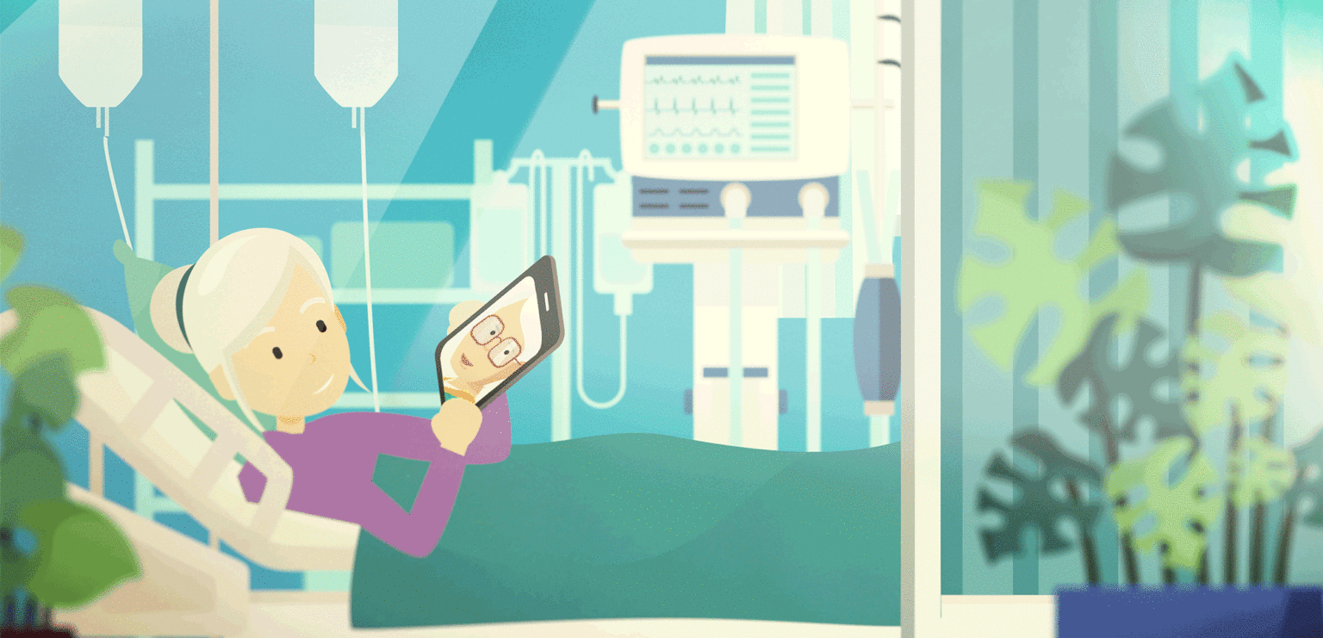

Slide 2
End of Life Doula
A Companion or A Friend in Death
I have been suffering from cancer for the last 10 years and have been so afraid. You have made it easier for me to think and talk about issues and I feel in control of the process….
I want this to end soon and I do not want to prolong my life .. need help to say this to my family

Slide 3
End of Life Doula
A Companion or A Friend in Death
I am afraid…please don’t leave me ….
Before Covid – 19, a fellow Doula and I ran a death café once a month providing opportunity for all mortals to drop in and talk about death and dying
Notes:
My last example is for a mother of 5. Mary was constantly saying "I am afraid, please don’t leave me“. Death to some is fearsome and lonely. I have had the opportunity to take time to sit with Mary who was dying, to hold space. I sat holding her hand and asked her, what was she afraid of? and she said she did not know. She was of catholic faith so I sat praying for her, she was listening, her eyes closed, gripping my hand tightly every time I moved to get comfortable, she would say "don't leave me". I invited her to hold the hand of Jesus as well and mine and when I was leaving her I told her Jesus will be holding her hand. When I enquired the following day, I was told she had calmed down and she died peacefully.
Before Covid–19, a fellow Doula and I ran a death café once a month providing opportunity for all mortals to drop in and talk about death and dying.

Slide 4
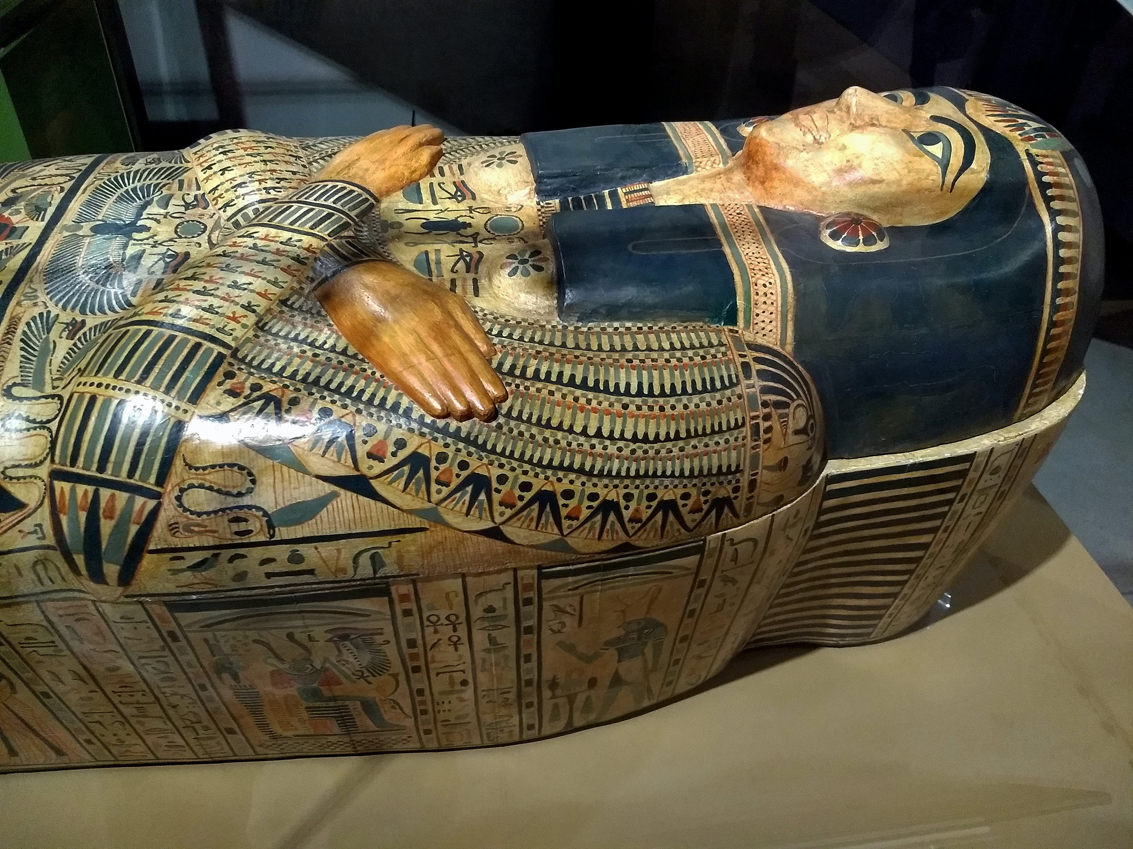
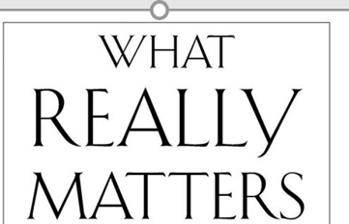
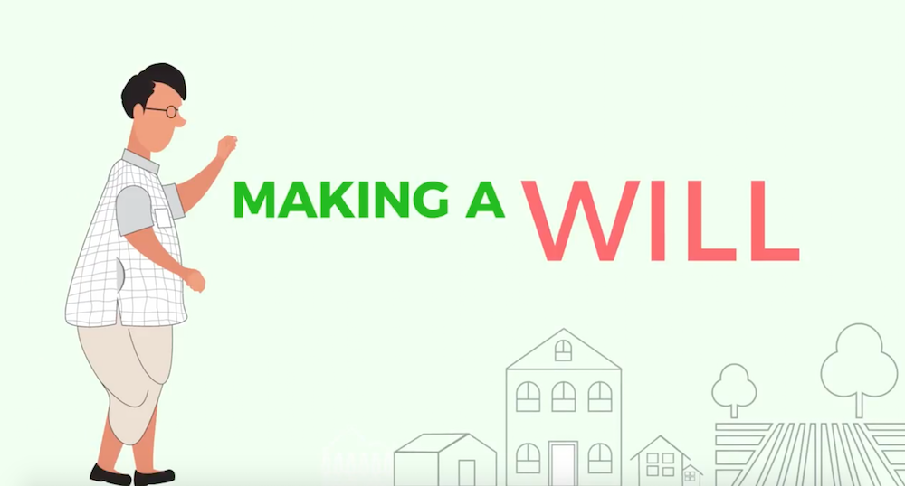
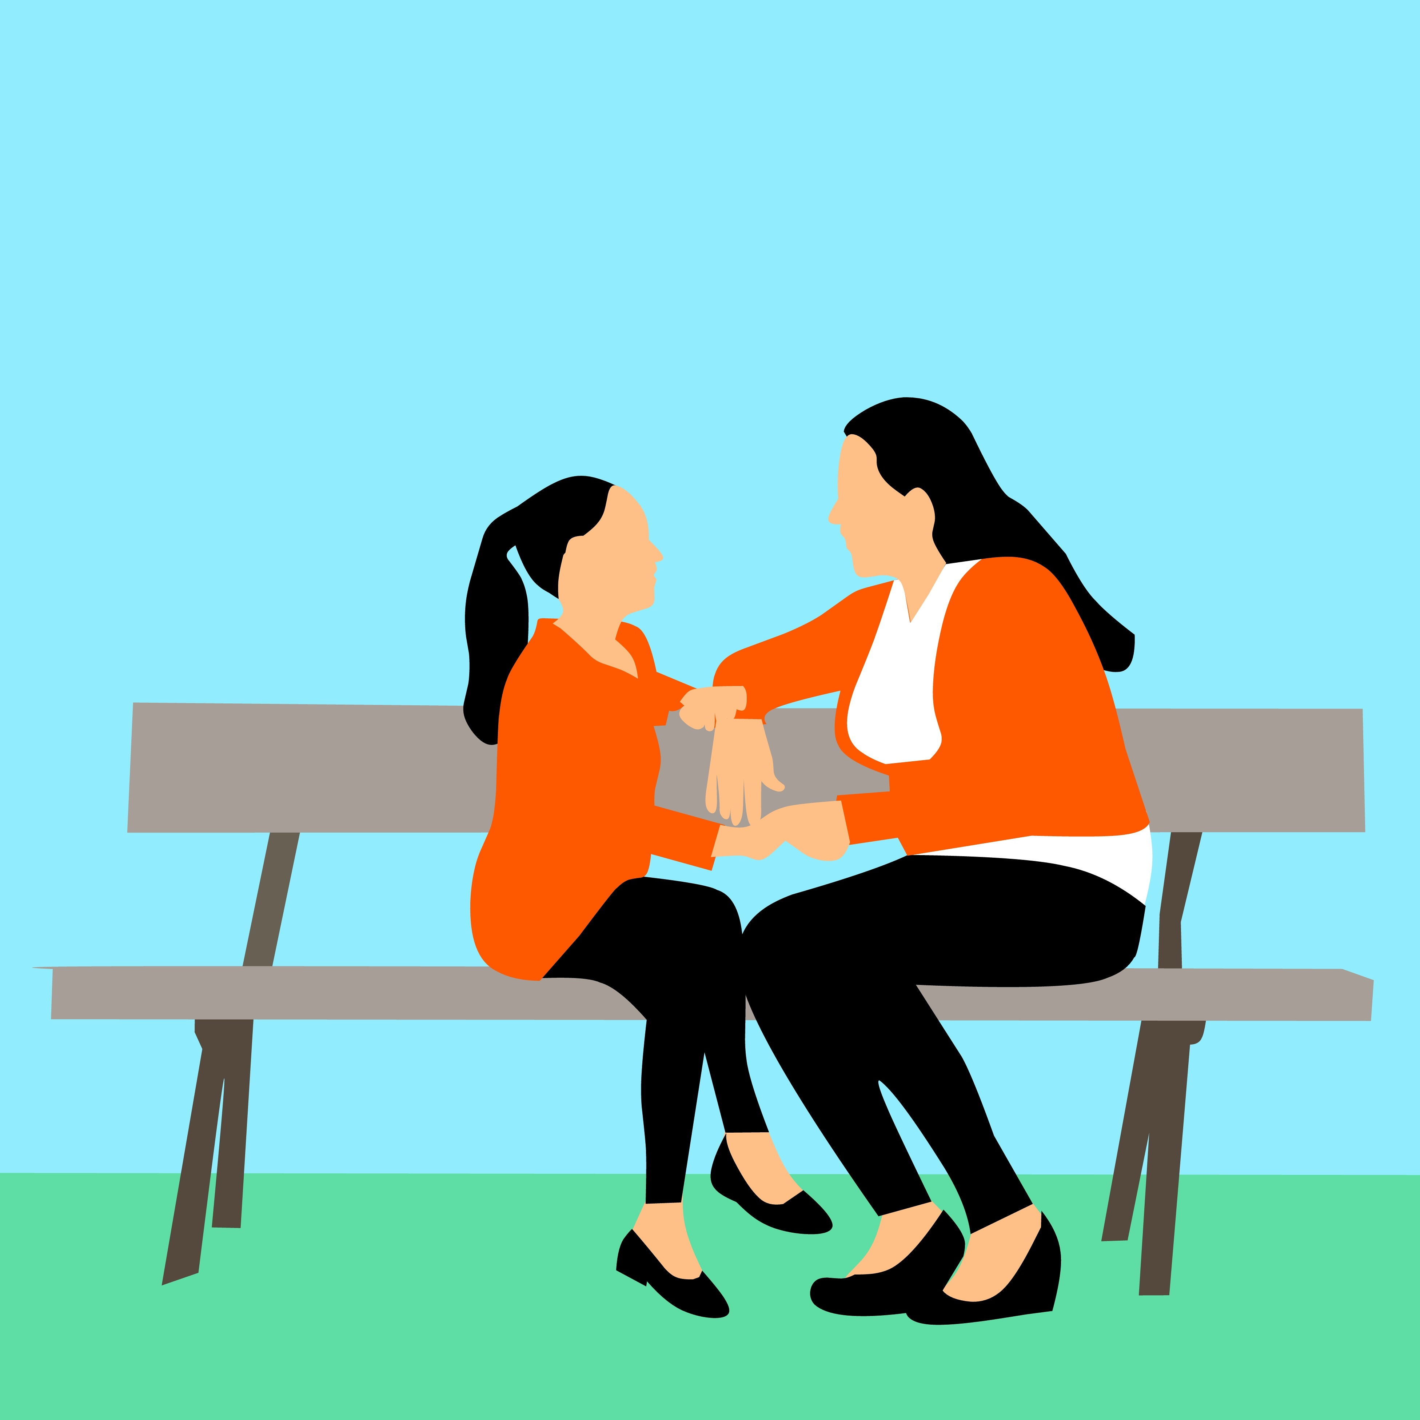
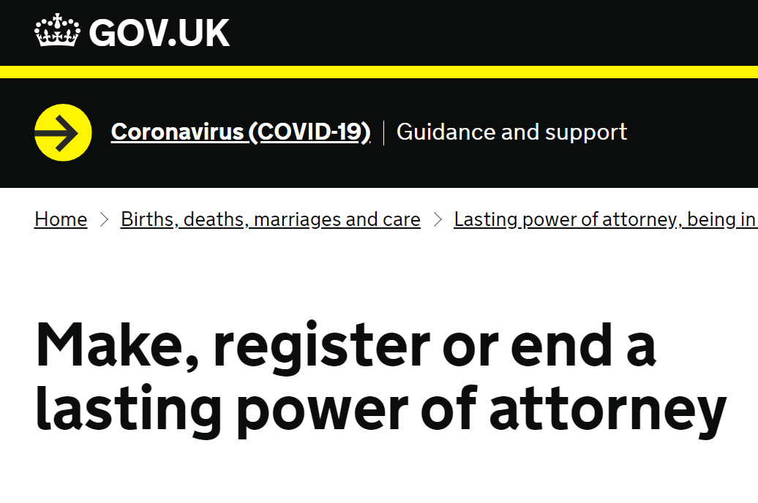

Working with My Faith Community
Dawoodi Bhora, Shia Muslim Community

